Slide 1
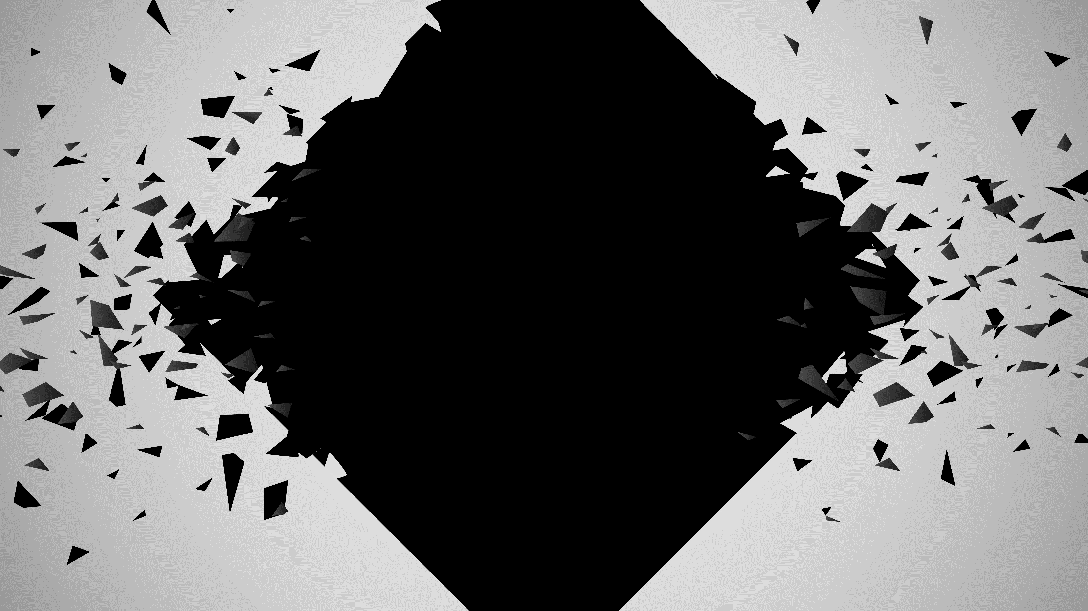
FRAGMENTS

Slide 2




BASICS

Slide 3

THEME
How deep is your love?
Trial
Self-acceptance
Working through
Past regrets
Reassembly

Slide 4

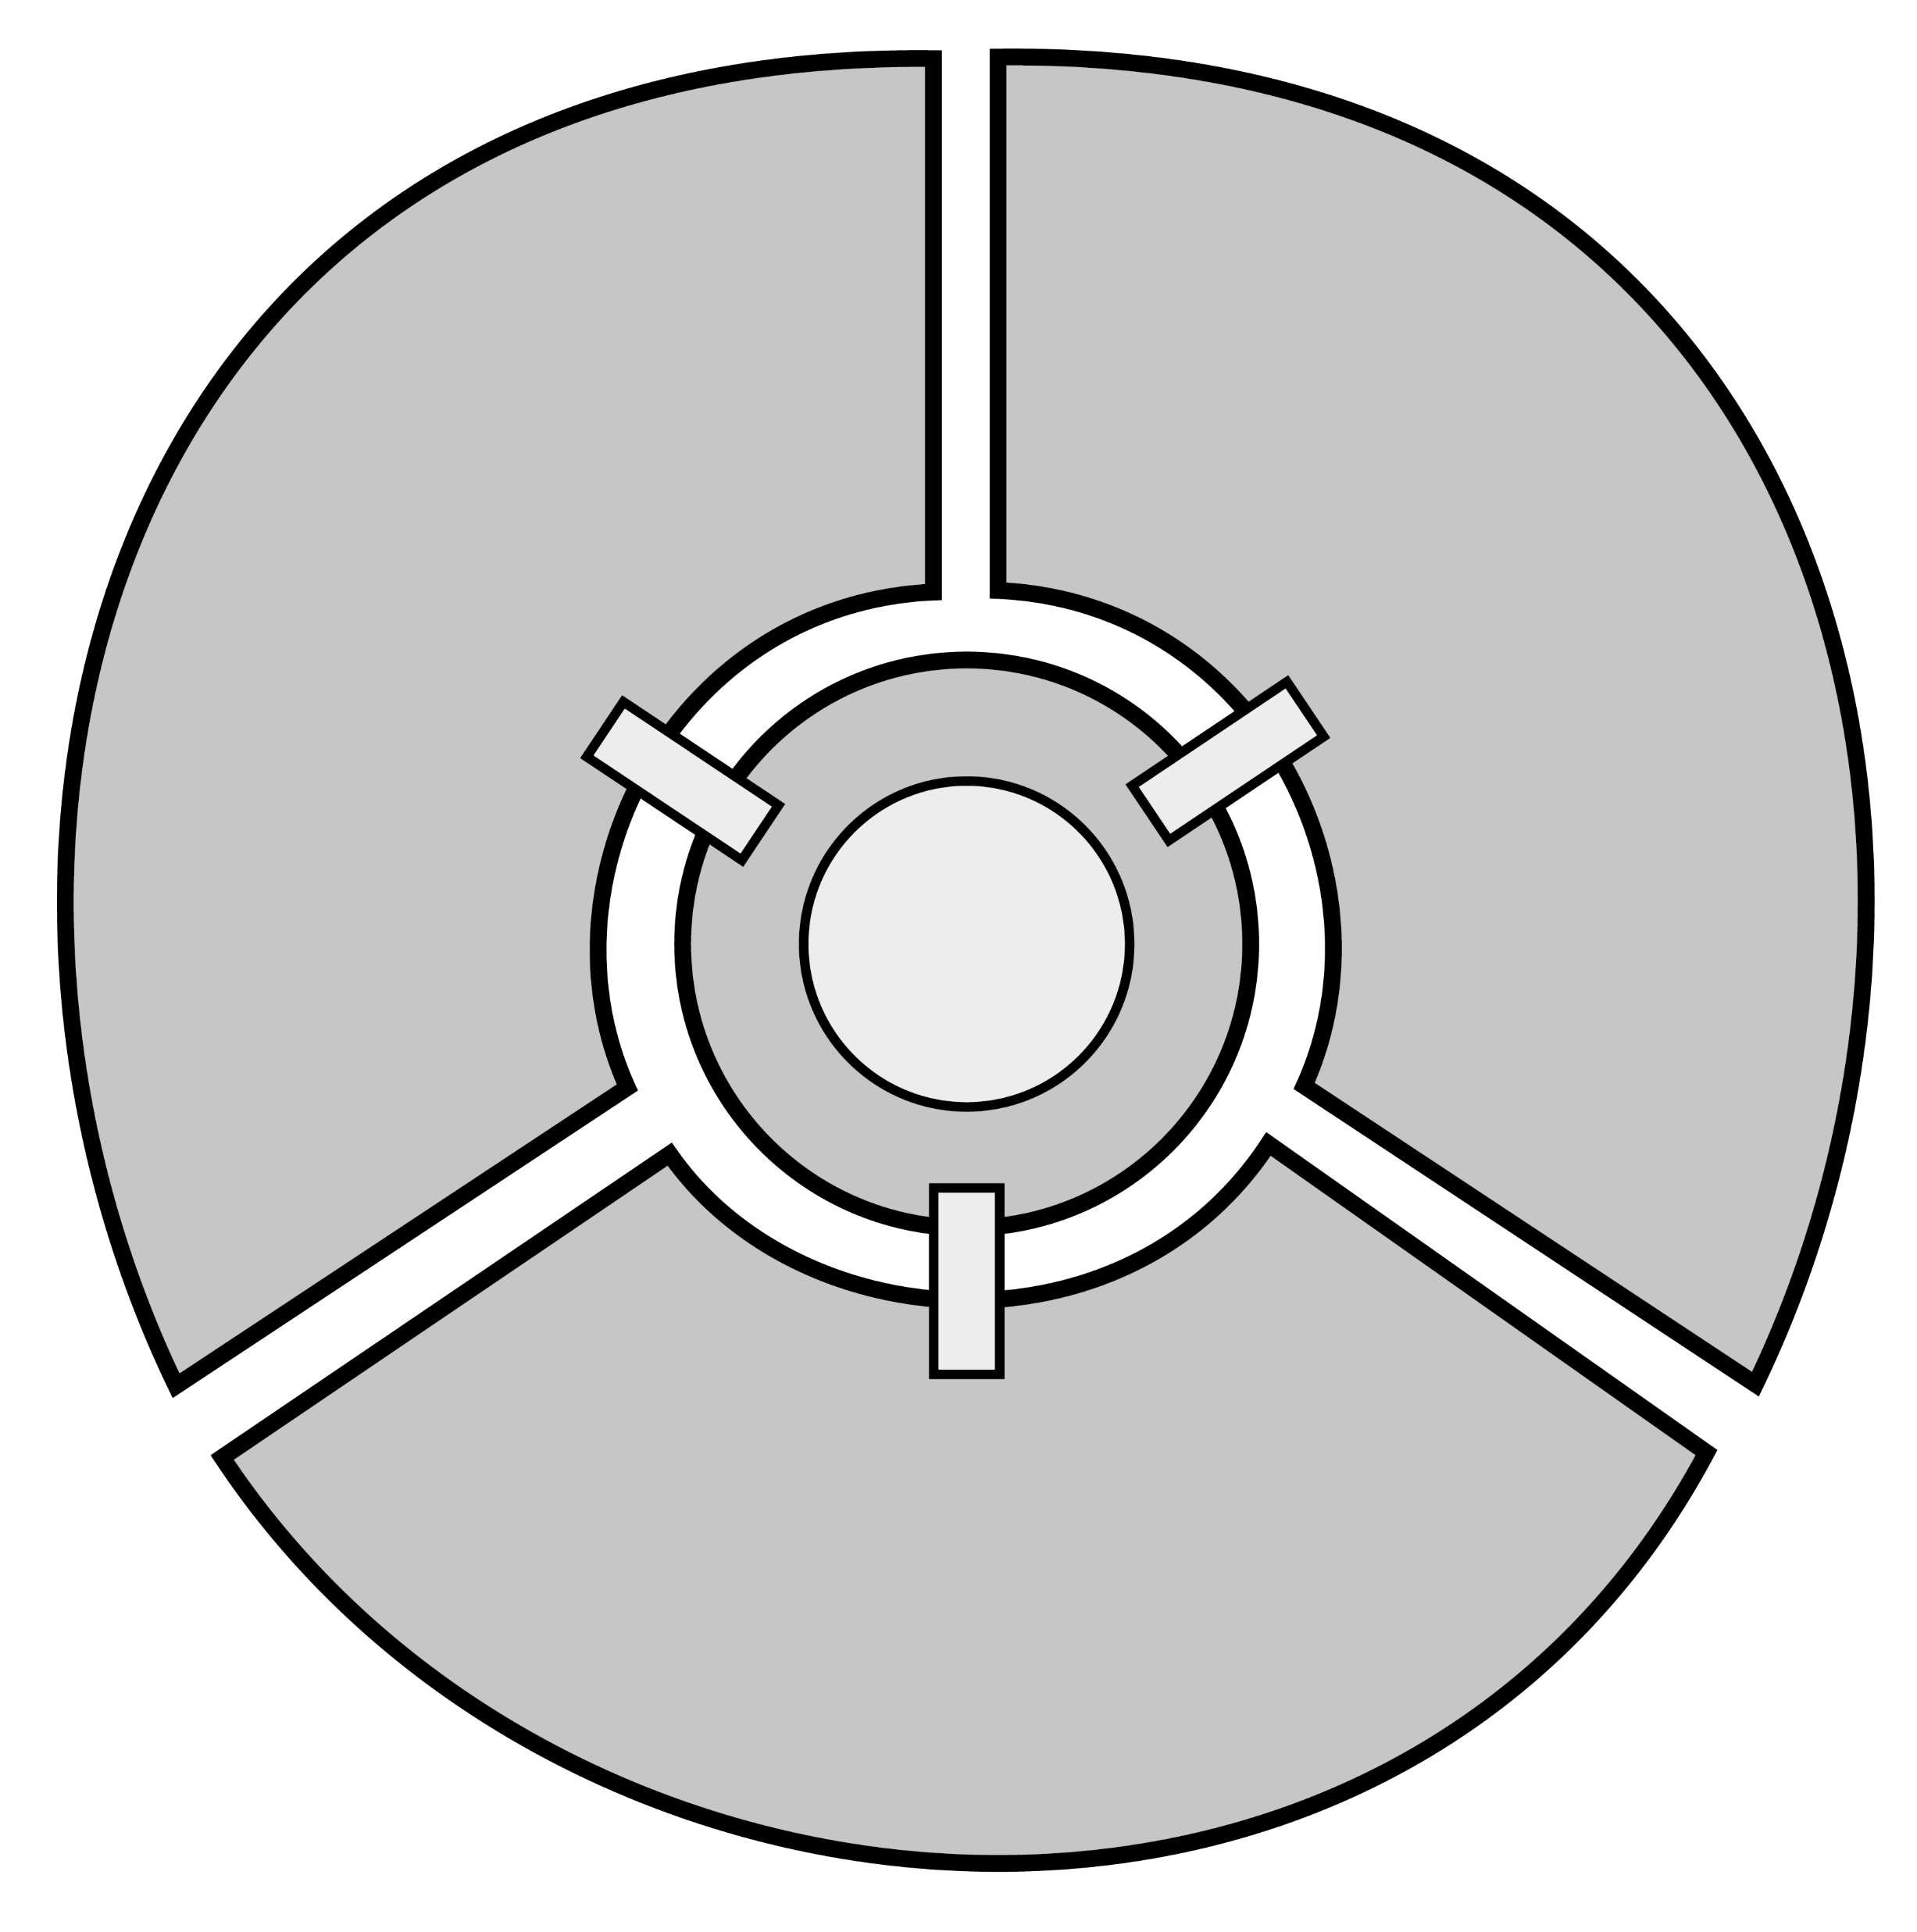

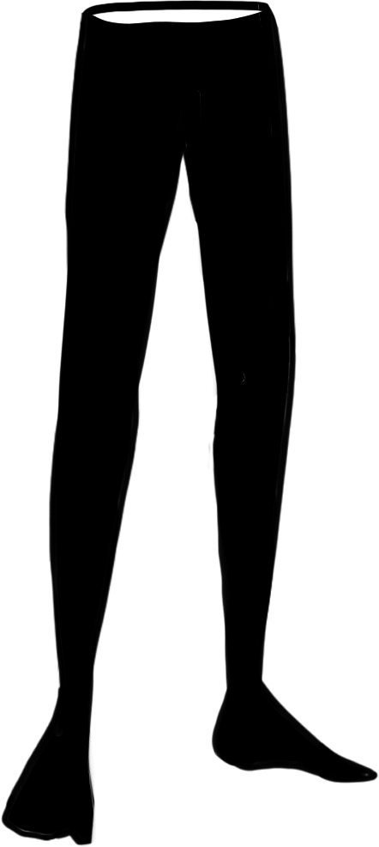
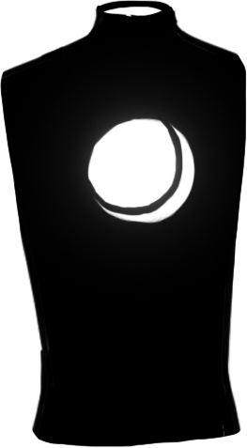
STRUCTURE

Slide 5

GAMEPLAY
Unlock
Learn
Enter
Collect
Analyze
Solve

Slide 6
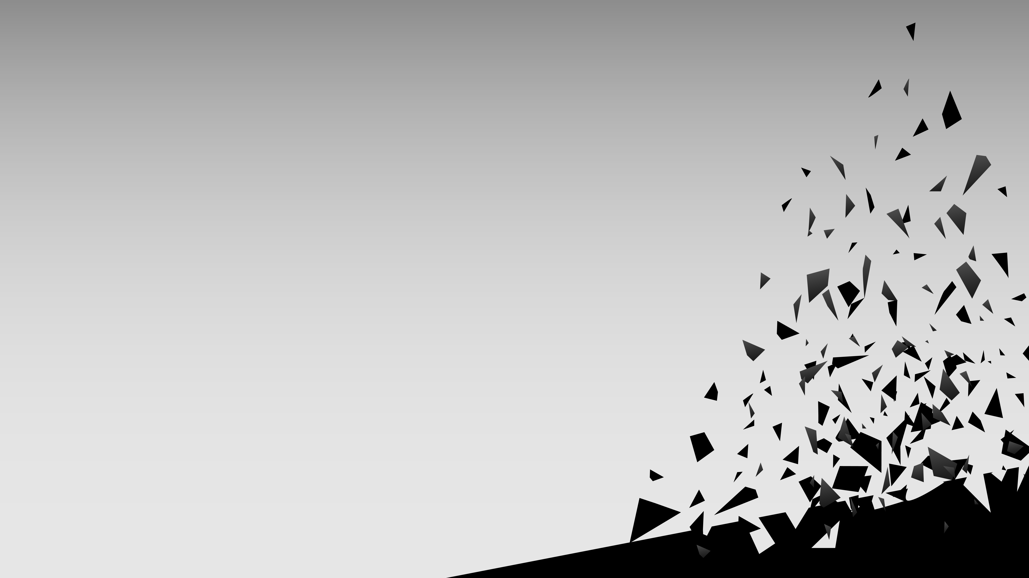
GAMEPLAY
Wall run Breathe out Hook shot

Slide 7



NARRATIVE

Slide 8
NARRATIVE
LEG = COWARDICE
Running away
Physically
From responsibility
Fire

Slide 9
TECHNICAL APPROACH
GitHub
Unreal Engine 4.22.2
Blueprints
Decoupled system
Technical debt

Slide 10
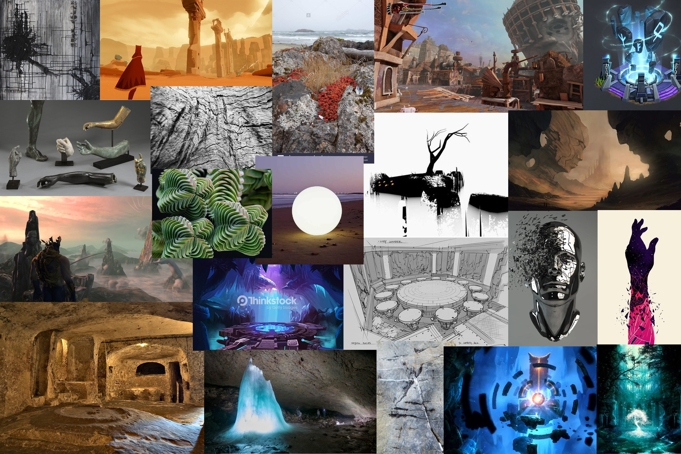
Art
Mood board

Slide 11
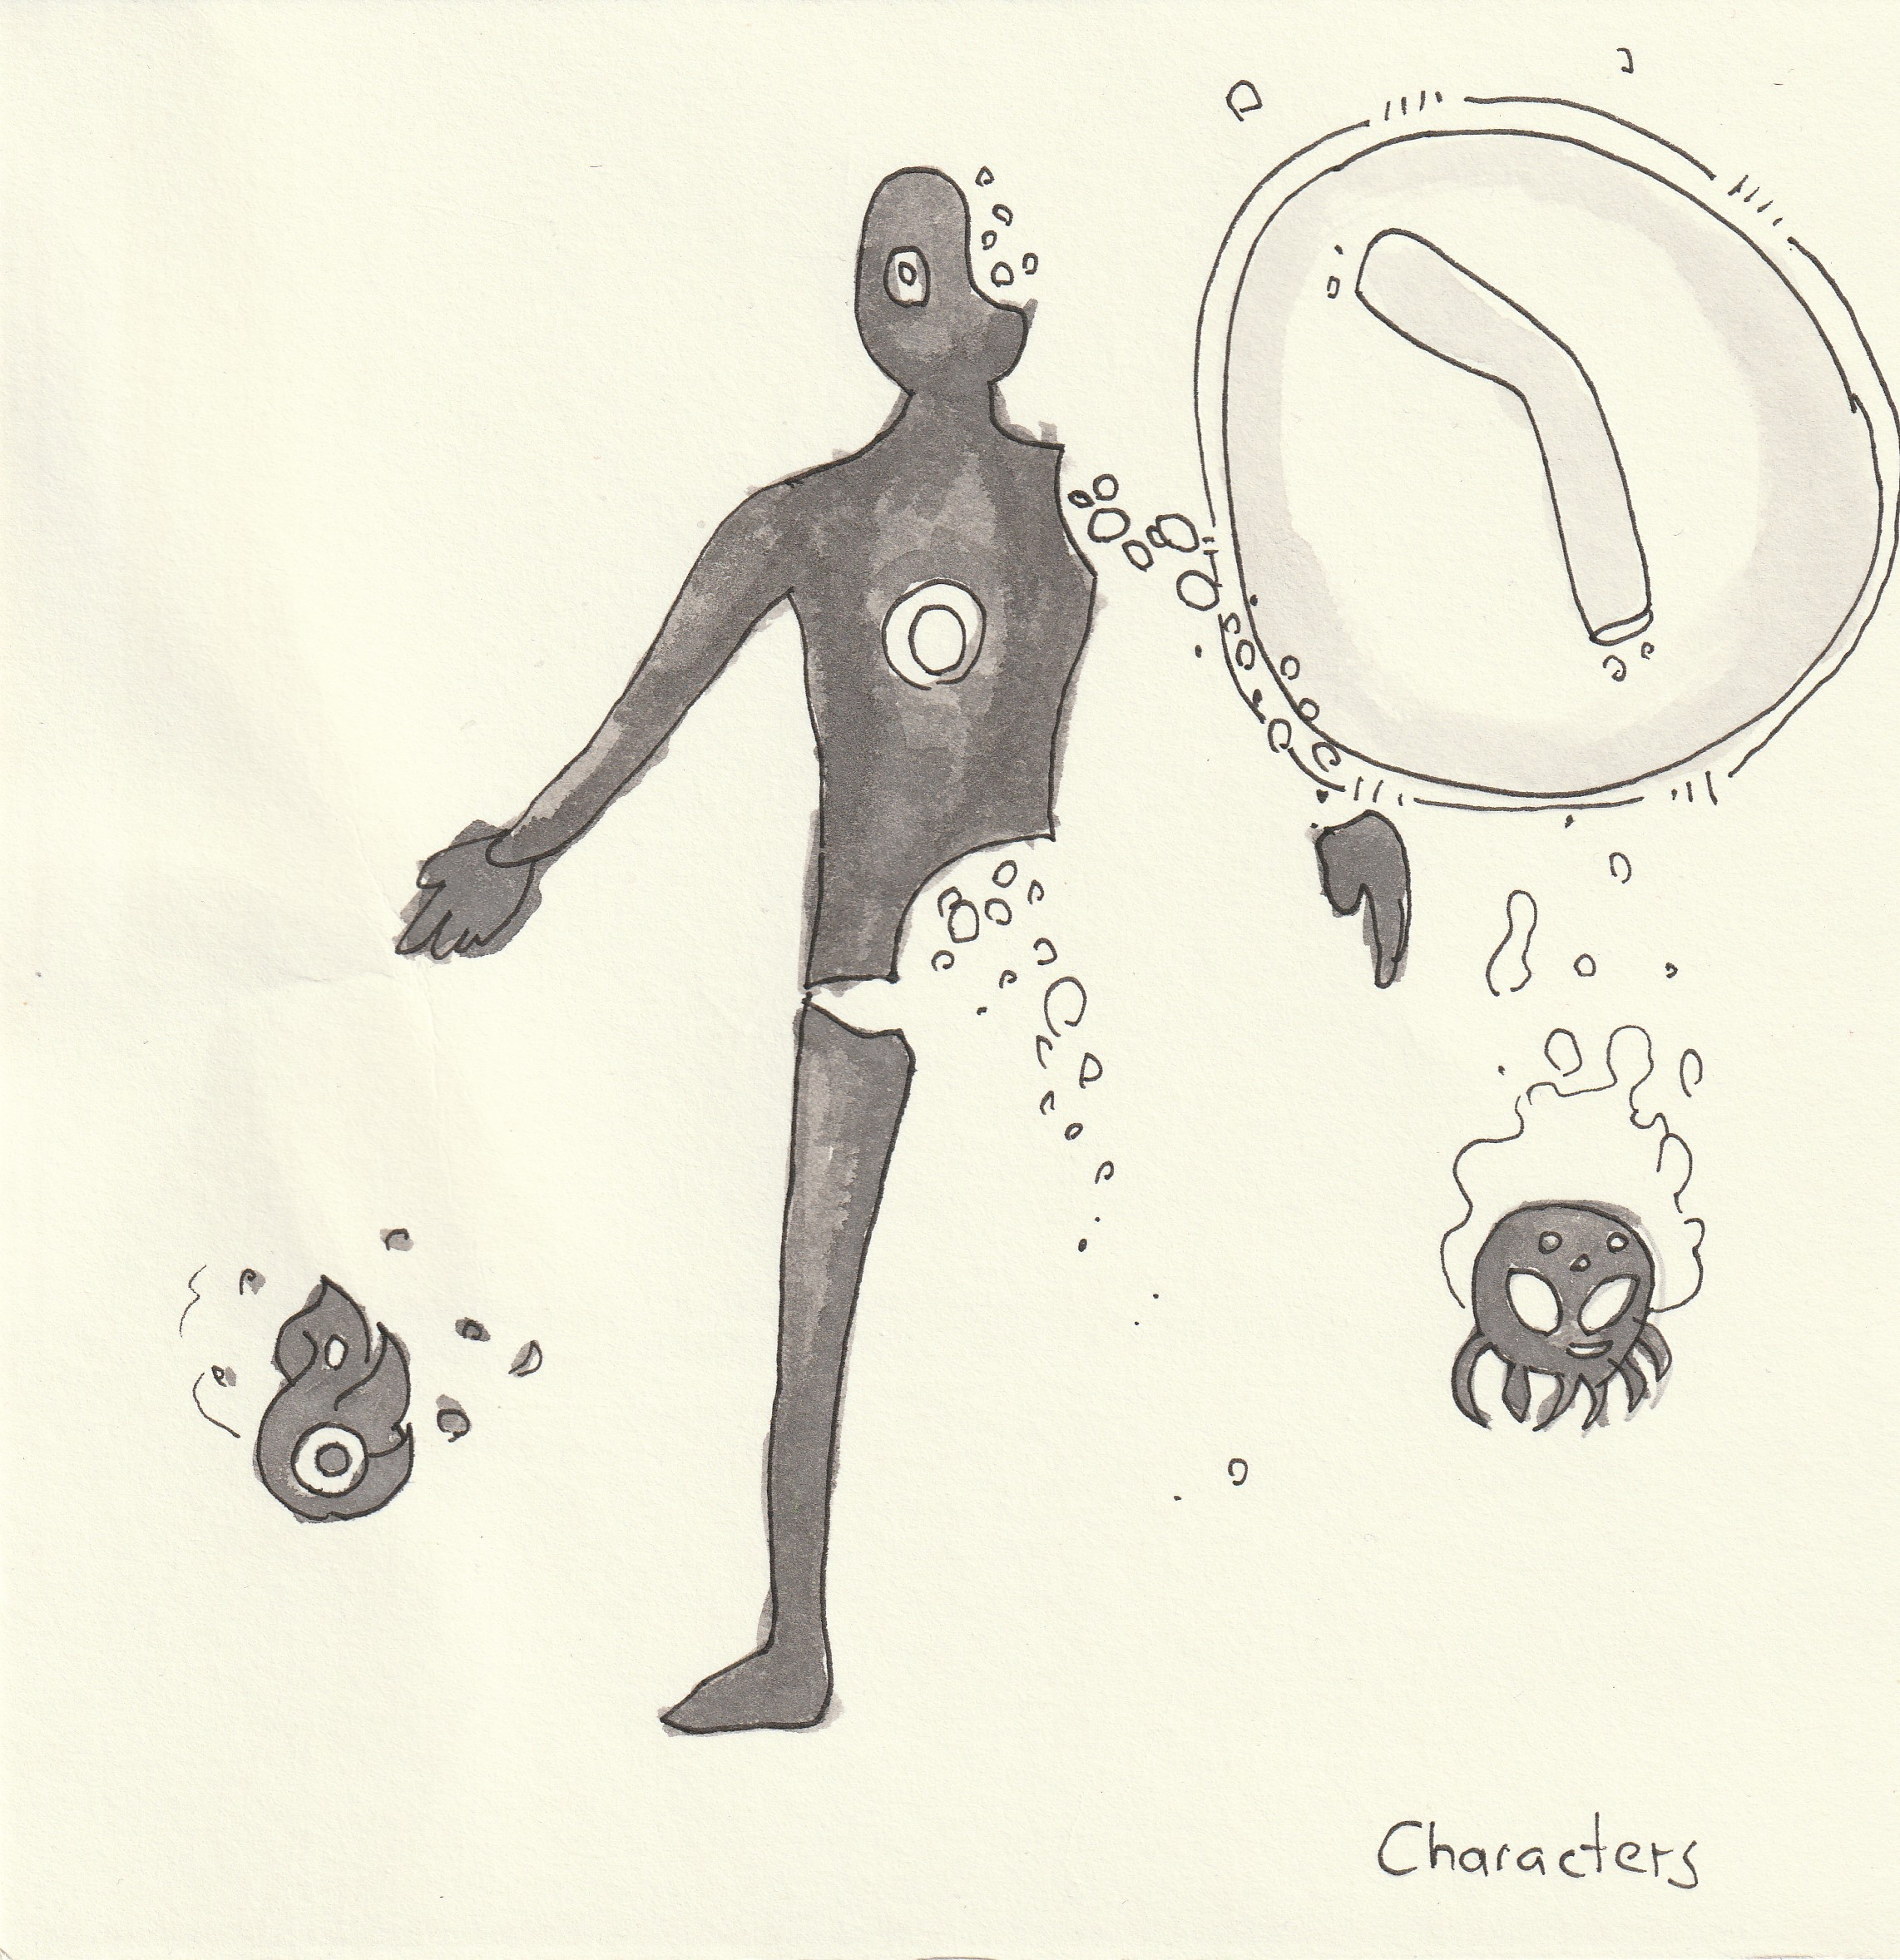
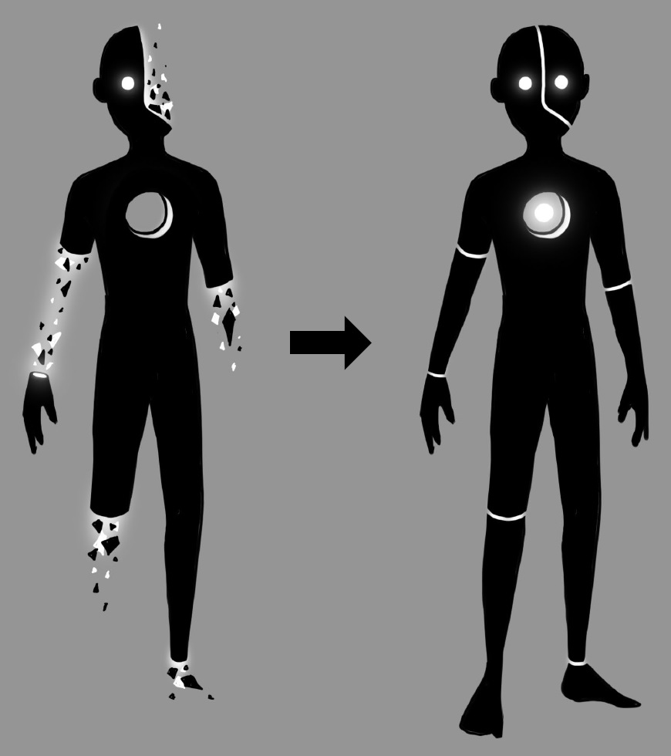
Art
Characters

Slide 12
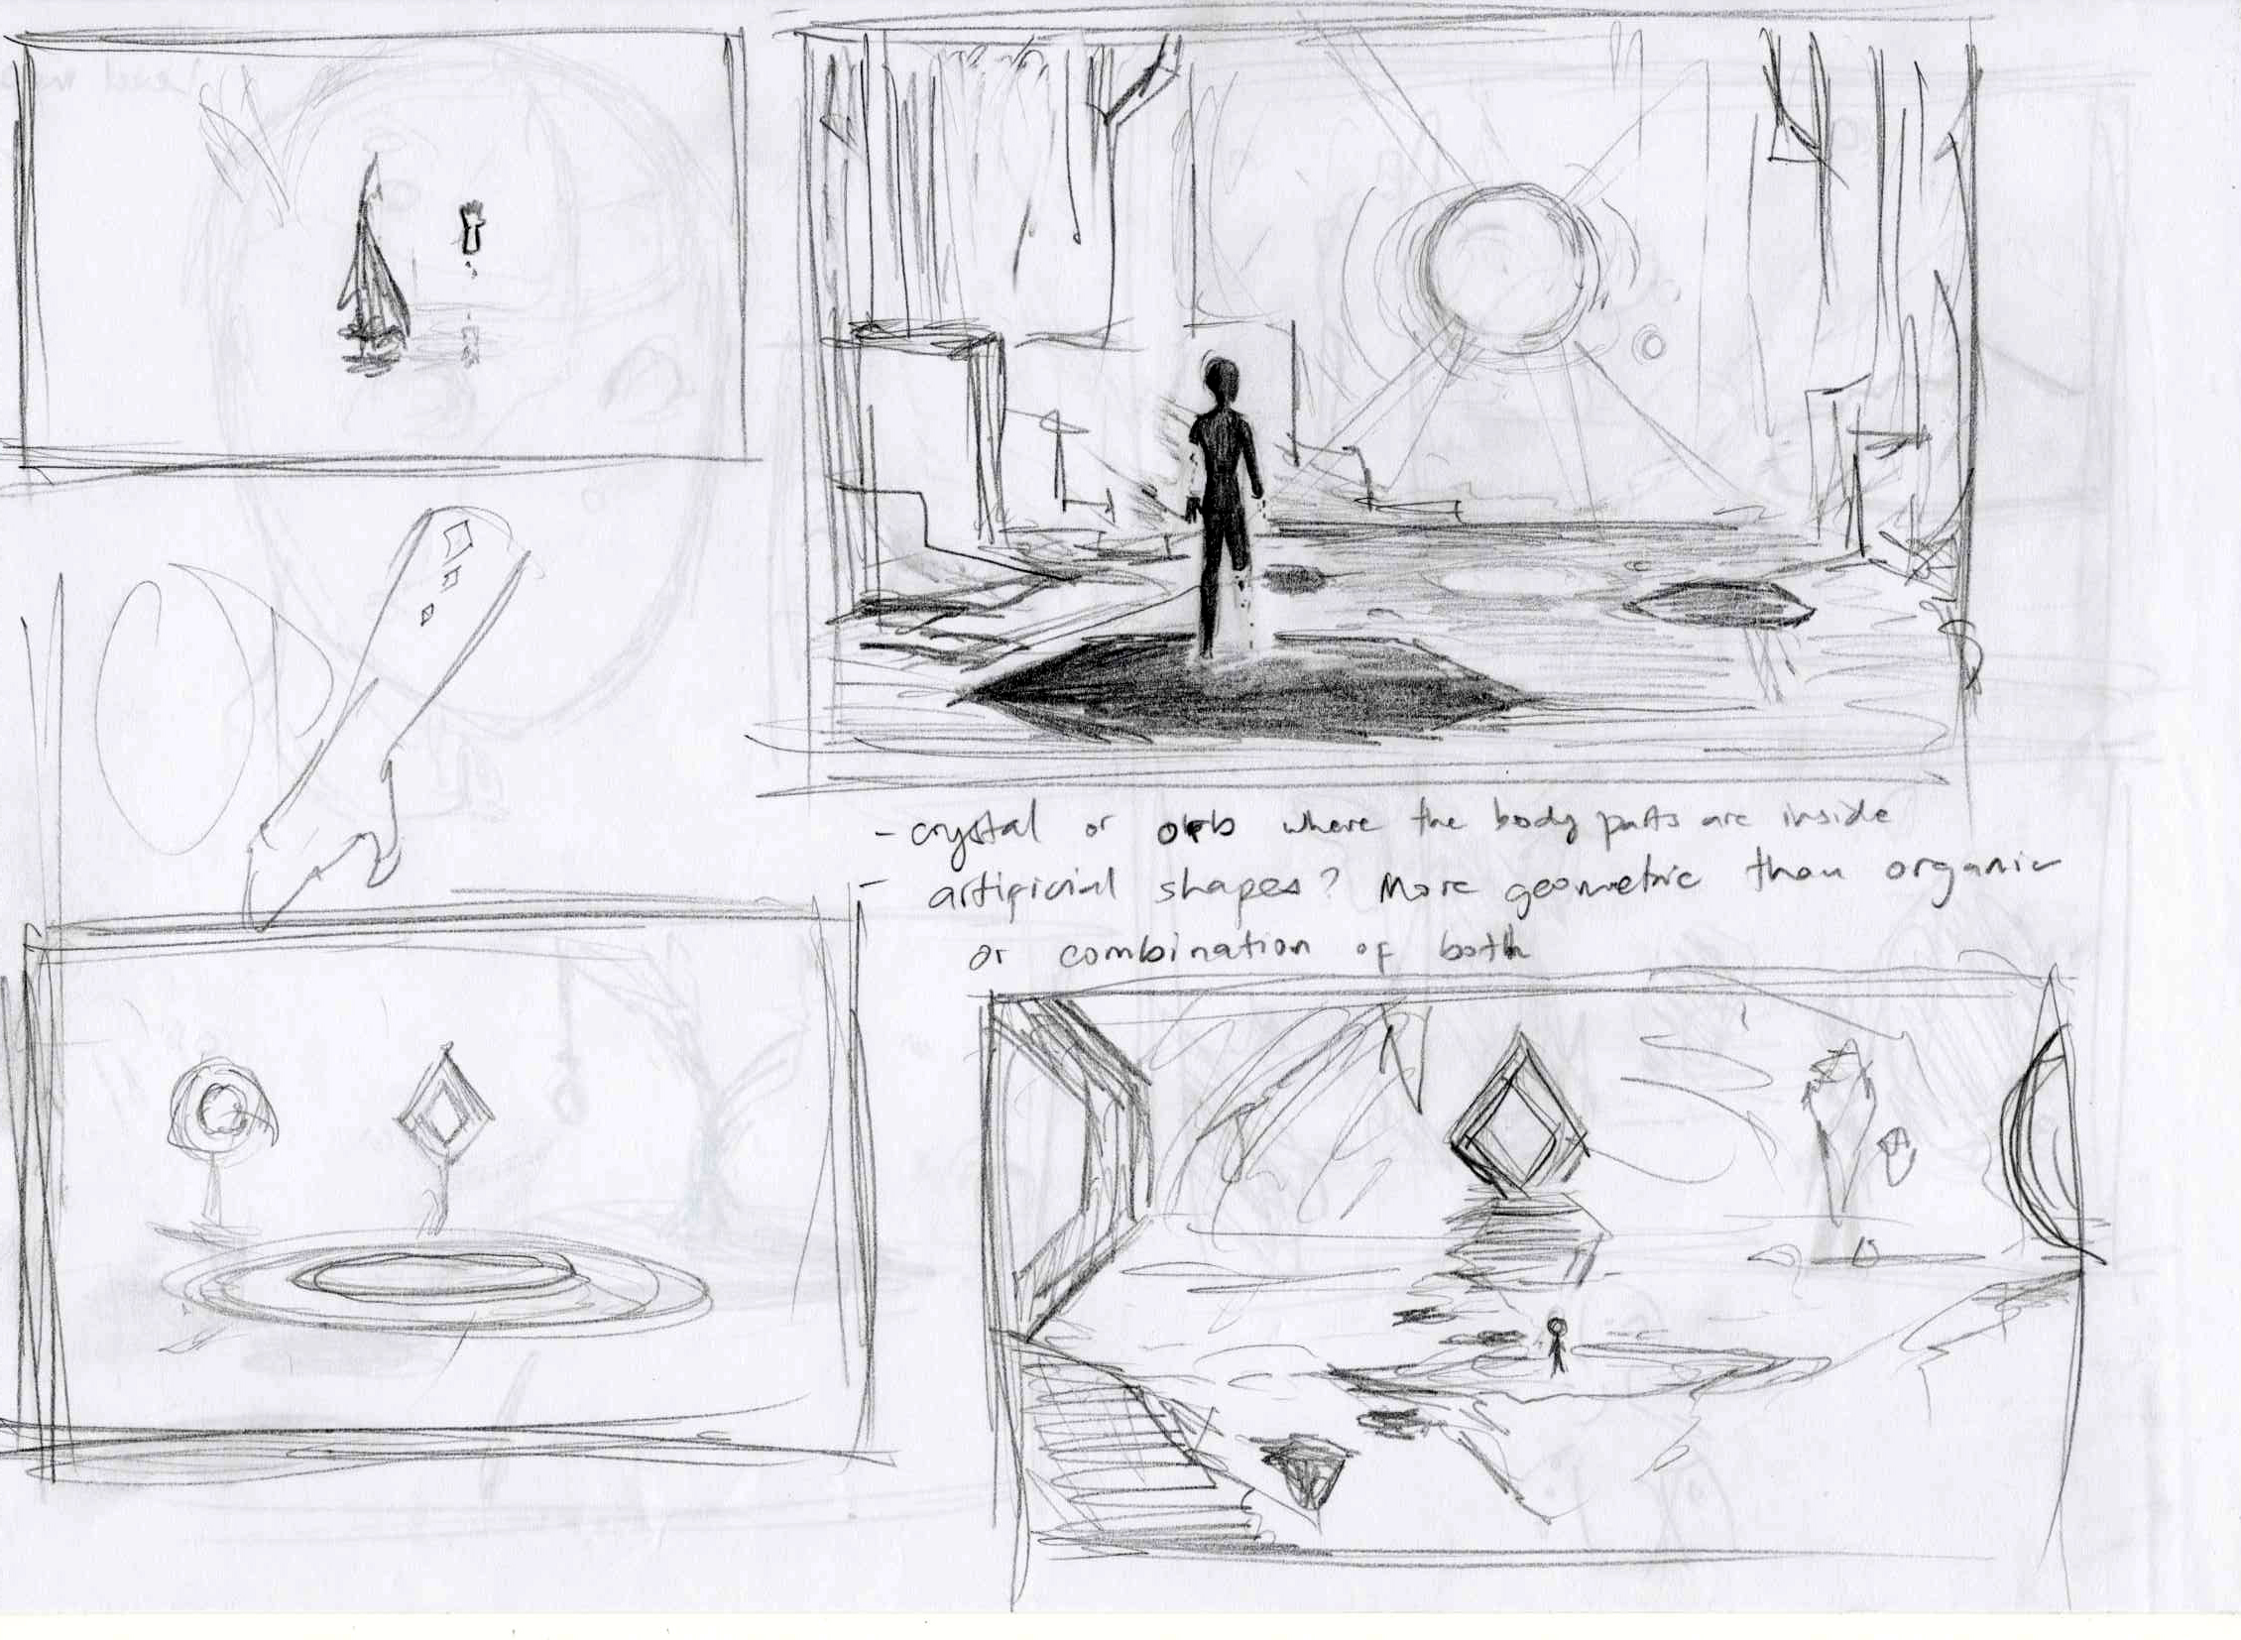
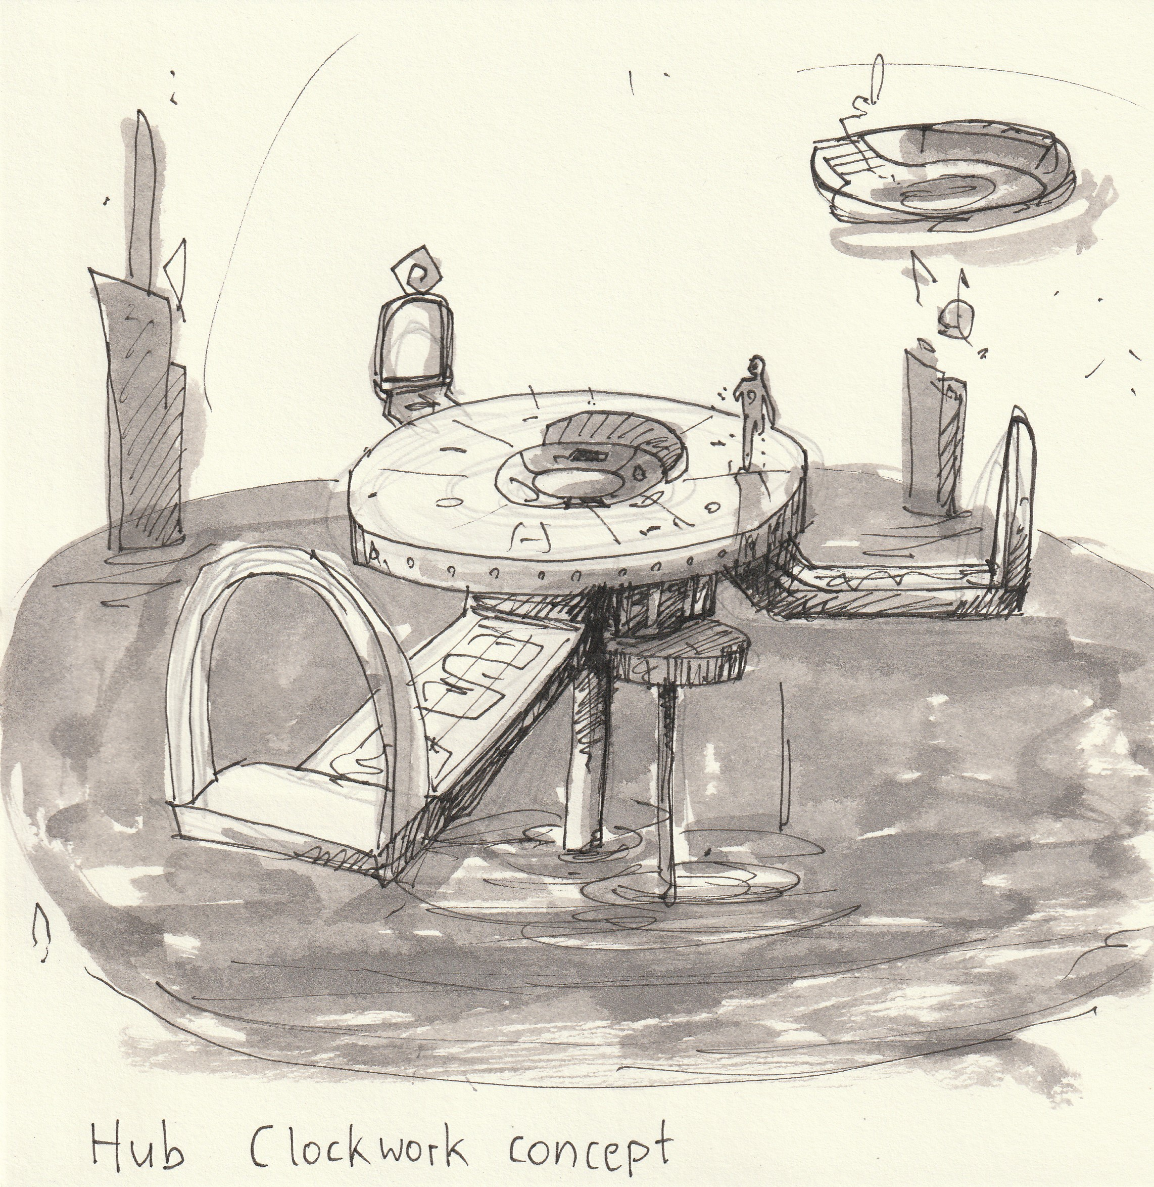
Environment
Art

Slide 13
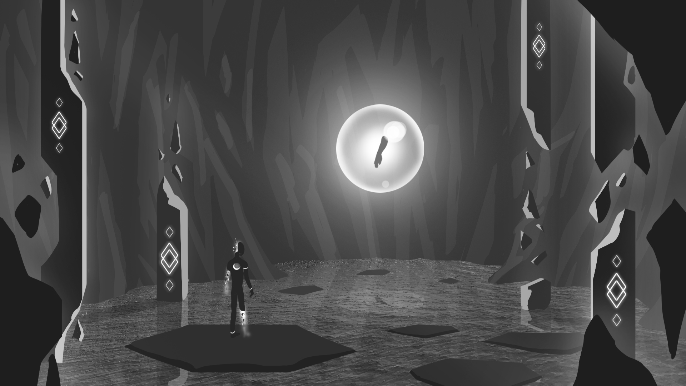

Slide 14
RIPOMATIC
[INSERT RIPOMATIC HERE]

Slide 15

THANK YOU!
Alexander Gerhards
Lead / Artist
Lars Kalthoff
Design
Trixia Quinzon
Artist
Daniel Baracotti
Designer / Sound
Thiago Morano Gerding
Programmer

